Slide 1
HUMAN COMPUTER INTERACTION
Project - Flambé ,
Recipe suggester for a given set of Ingredients
SANIKA KARWA | HRISHIKA JOTWANI | VAISHNAVI K

Slide 2

Problem statement.
Everyday is a celebration with such easy-to-make and wonderful recipes with the ingredients at hand. With the varied diversity in India, there are various dishes to choose from and in various languages so our grandmas too can search at ease. Most resources where we get our recipe’s from are based off of international ingredients, things we can’t easily get in India.
To make this entire process more accessible, we suggest: Flambé

Slide 3
Understanding our customers.
We see that maximum people are from age group of 19-22
People prefer to have home cooked meals rather than ordering food.
59% people prefer to find a recipe based on the ingredients they have at hand.
We see that 42% people are vegetarian and 34% people are non-vegetarian
From the survey we see that most people prefer to make Indian, Chinese and Italian food
We also see that the recipes looked for main course is more than that of desserts and starters.

Slide 4


I want something tasty with something i already have
I want something with local ingredient that i can find easily
Why can’t I find anything with all the ingredients I have
This is really hard, I’m wasting too much time
I want something vegan or vegetarian
This is very inconvenient and expensive
SAYS
THINKS
DOES
FEELS
Confused
Has to buy new ingredients according to recipe
Overwhelmed
Search different recipes according to interests.
Looks up for each ingredient in english and where to buy other ingredients
Annoyed

Slide 5
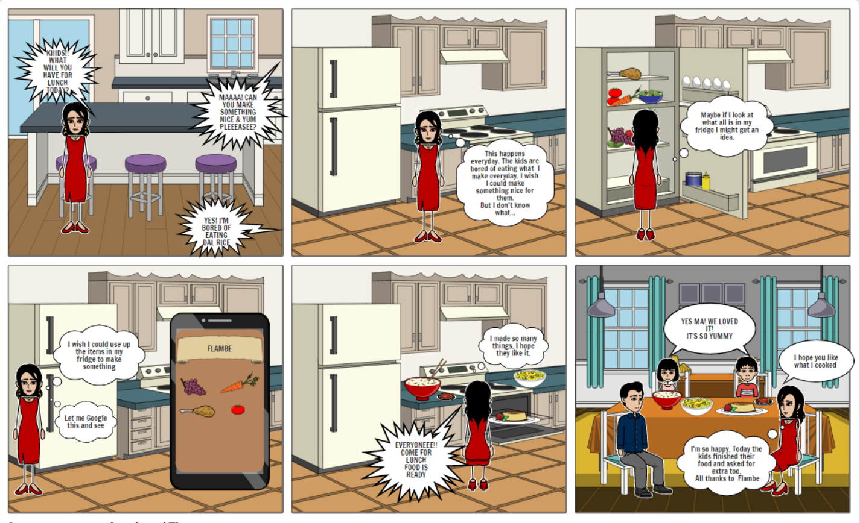
This is the story of a 40 year old homemaker, Tina

Slide 6
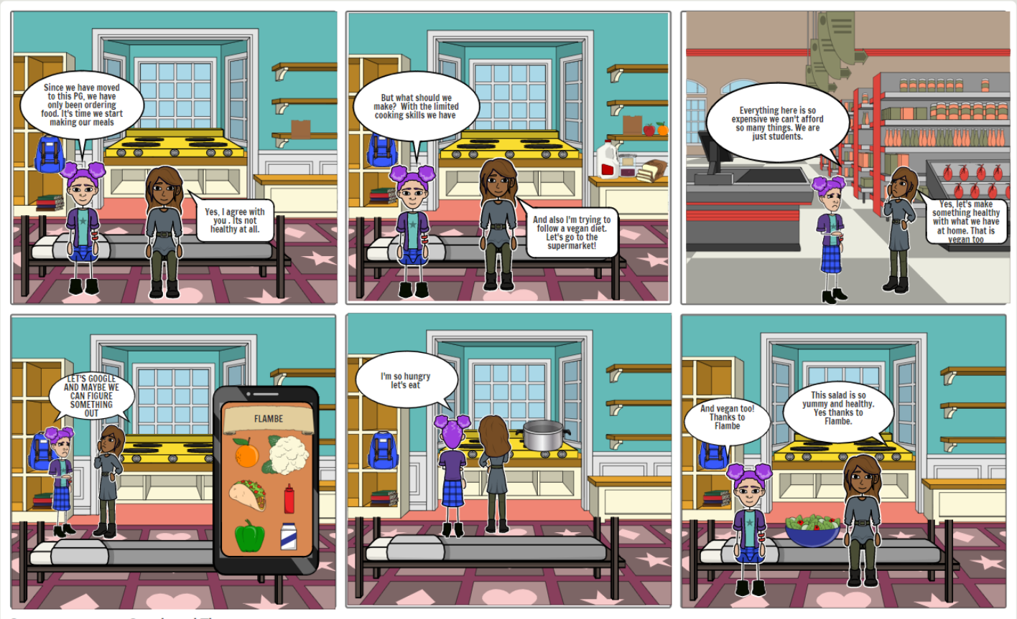
This is story of two students who live alone in PG

Slide 7
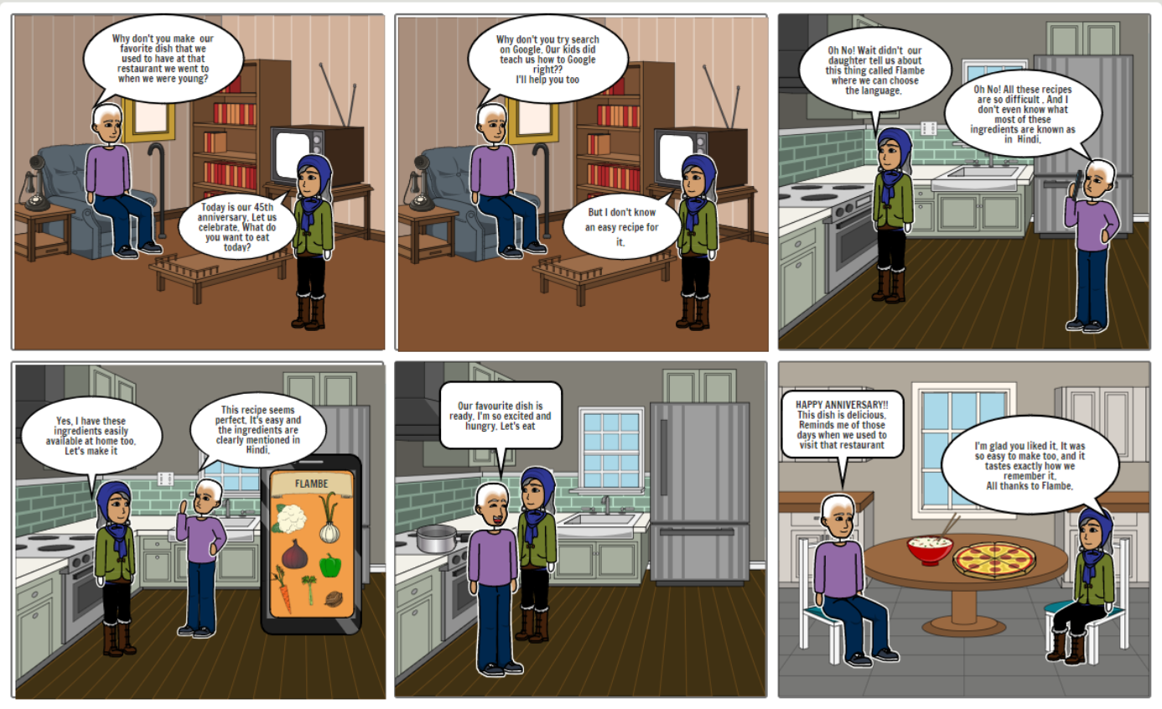
This is the story of a old couple

Slide 8
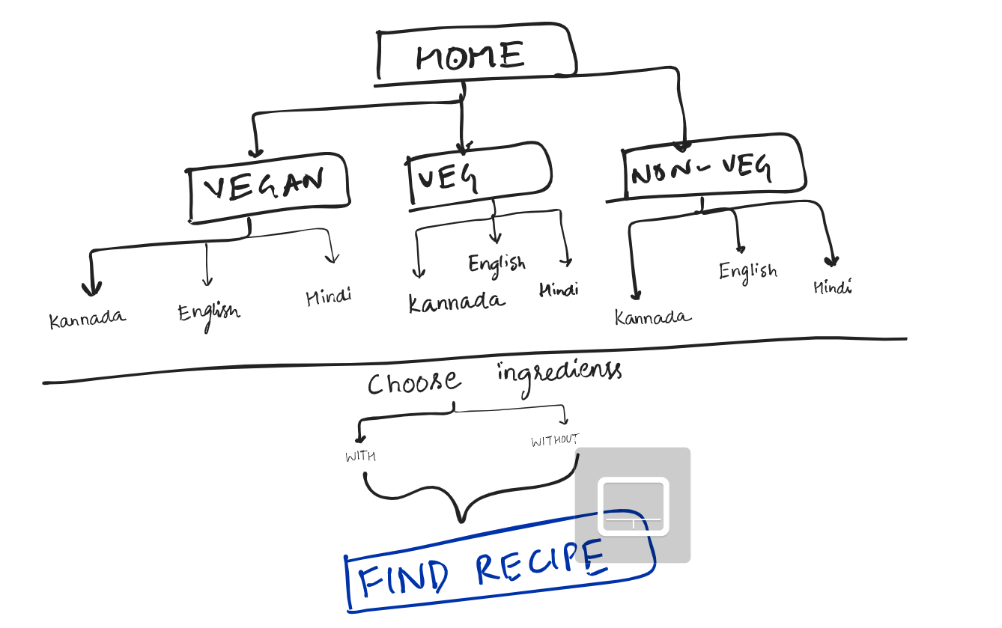

Mind Map.

Slide 9

Choose your Diet
Choose from various options like vegetarian, vegan and non-vegetarian
How Flambé helps.
Choose your Language
Choose the language you are comfortable in- Hindi, English and Kannada
Add Ingredients
Add available ingredients at hand
International recipe’s but with Indian ingredients
Voila! You have your recipe
Find the recipe according to your interests

Slide 10
Heuristic Evaluation.
Heuristic | Myfridgefood | Flambe
Visibility of system status | DONE | DONE
Match between system and real world | Not convenient for Indian users | DONE
User Control and freedom | Partially convenient | Partially convenient
Consistency and standards | DONE | DONE
Error prevention | DONE | DONE
Recognition rather than recall | NO | DONE
Flexibility and efficiency of use | NO | DONE
Aesthetic and Minimalist design | NO | Convenient
Help users with errors | DONE | DONE
Help and documentation | NO | DONE

Slide 11
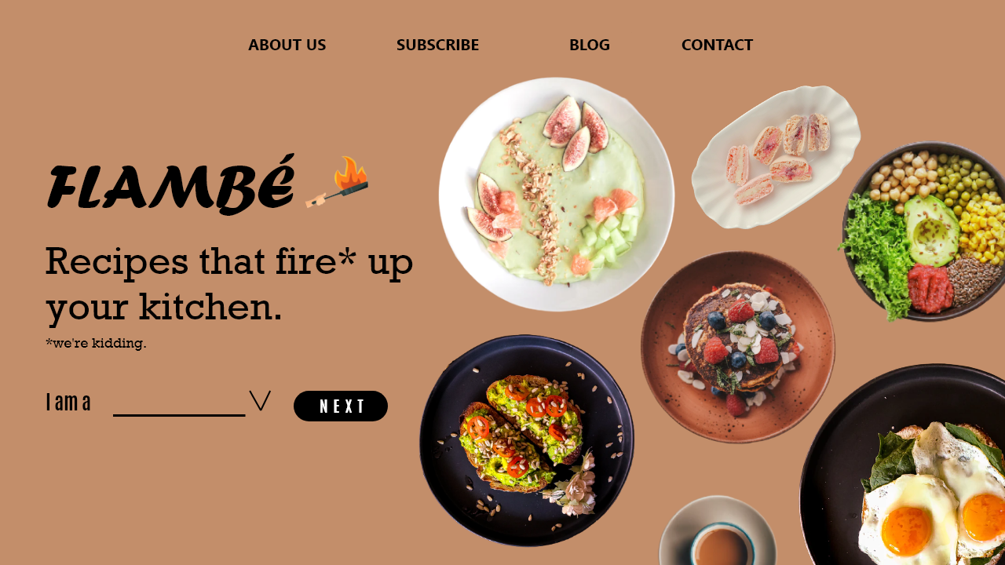
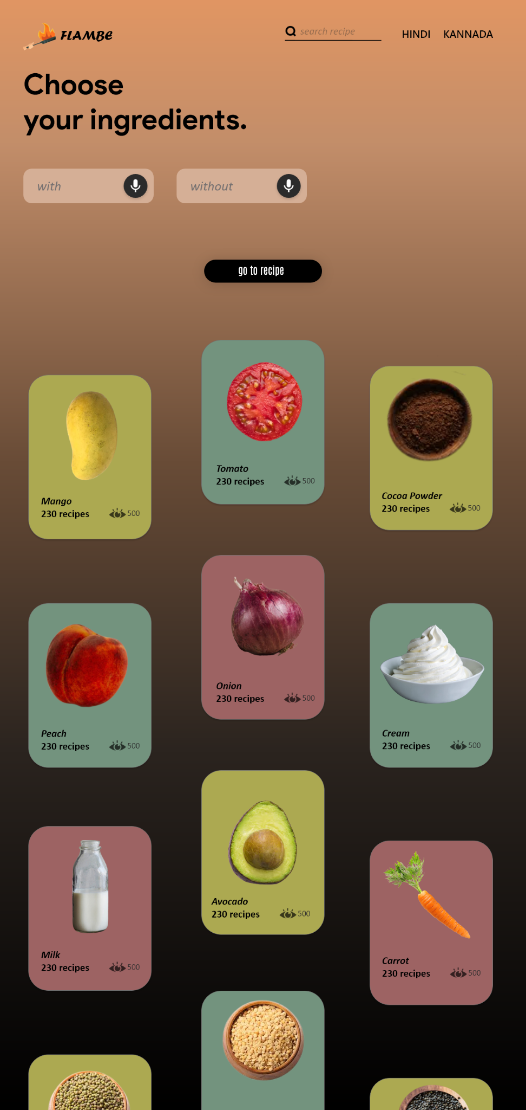
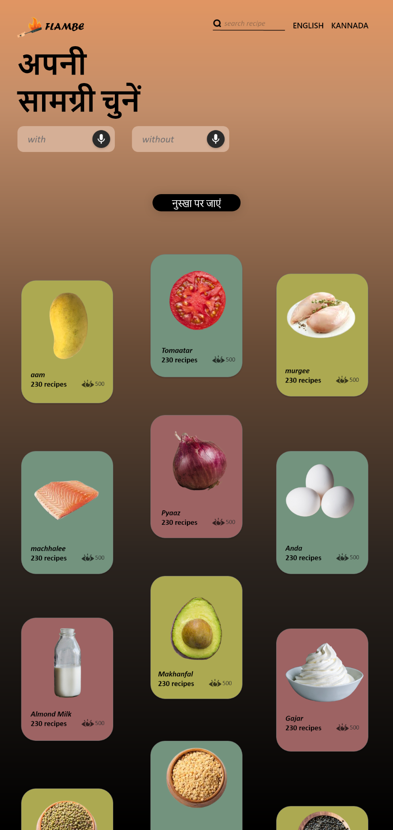
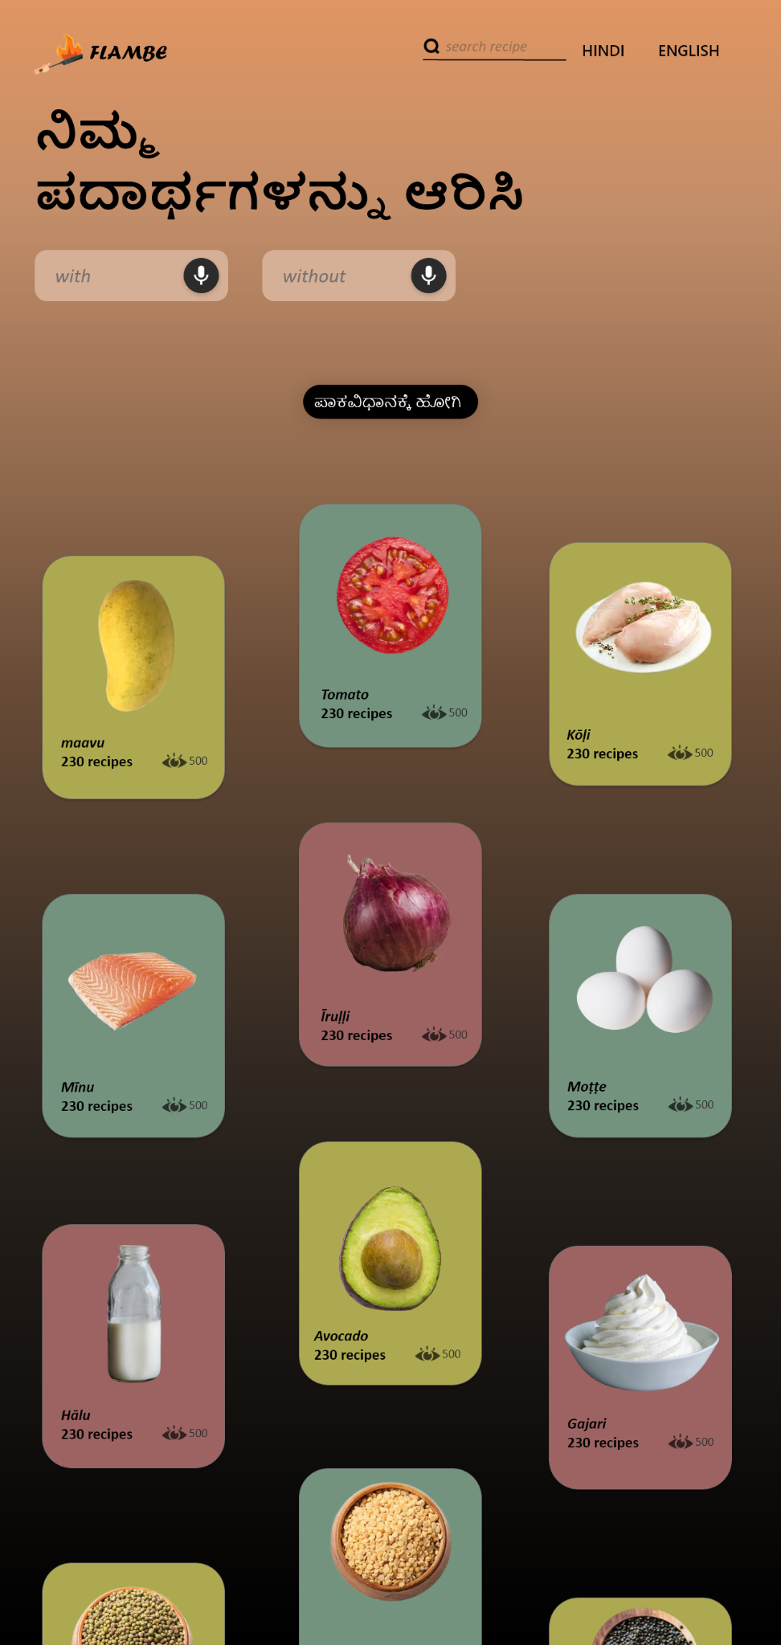
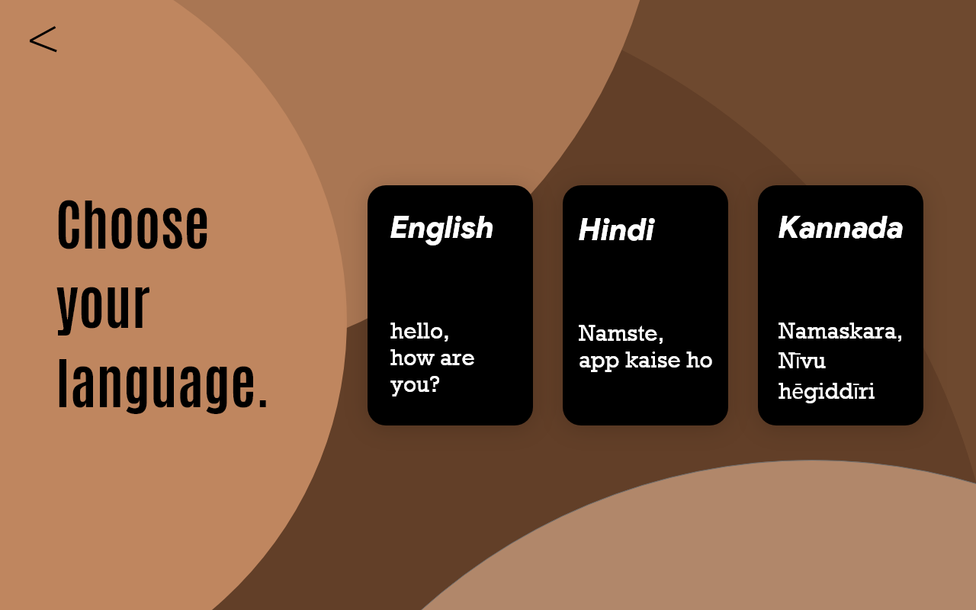
High fidelity designs.

Slide 12
THANK YOU.
THANK YOU.

